Slide 1
Pixel Editor
Rahul D Shetty
4NM16CS111

Slide 2
Abstract
Pixel Editor : Multi-purpose Image Editing Tool for Windows Platform.
Features :
Image Smoothening.
Morphological Operations.
Image Filtering.
Transformations.
Histogram Equalization Techniques.
Easy to use GUI.
Low System Requirements.
Built using C#.

Slide 3
Problem Statement
Hardware Requirements.
Memory
CPU
Storage
GPU
Not User Friendly.
Need for learning Programming Language.

Slide 4
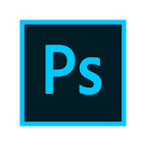

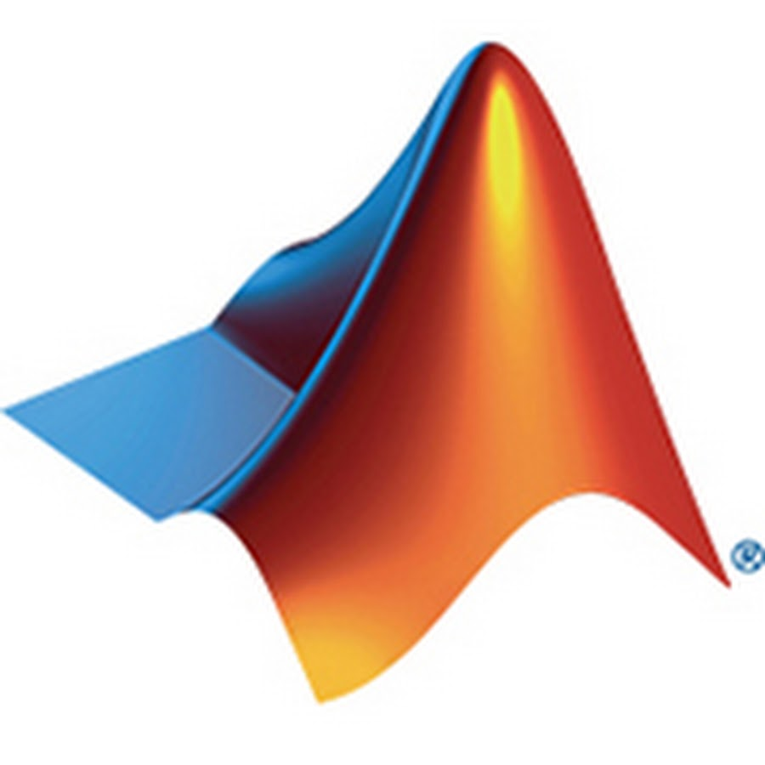
Existing Tools/Solutions
Photoshop
Rich Features.
Easy to use UI.
Cross Platform.
MATLAB
Programming Language.
Complex Maths Operations.
Cross Platform.
GIMP
Open Source.
Free.
Cross Platform.

Slide 5
Solution
C# Implementation.
Good UI Design.
Faster Computation.
Filtering Techniques.
Blurring.
Edge Detection.
Additional Filters.
Morphological Operations.
Erosion.
Dilation.
Open / Close.
Transformation.

Slide 6
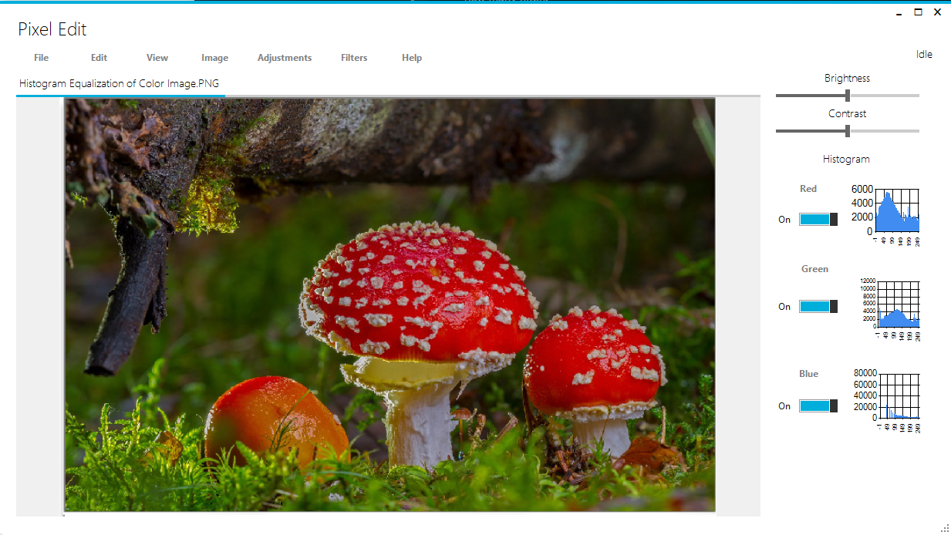
UI Design

Slide 7
DEMO

Slide 8
Conclusion
Project Objectives.
Cross Platform Support. ( Mono )
Further Improvements
Features.
Performance.
Additional GPU Support.

